Slide 1
Decentralized distribution of HIV medications
Decentralized Drug Distribution Application
(DDD App)
July 23, 2020

Slide 2
Agenda
Introductions
Basic features of the DDD App
Live demo
Experience with using the App in Nigeria
Discussion

Slide 3
Agenda
Introductions
Basic features of the DDD App
Experience with using the App in Nigeria
Live demo
Discussion

Slide 4
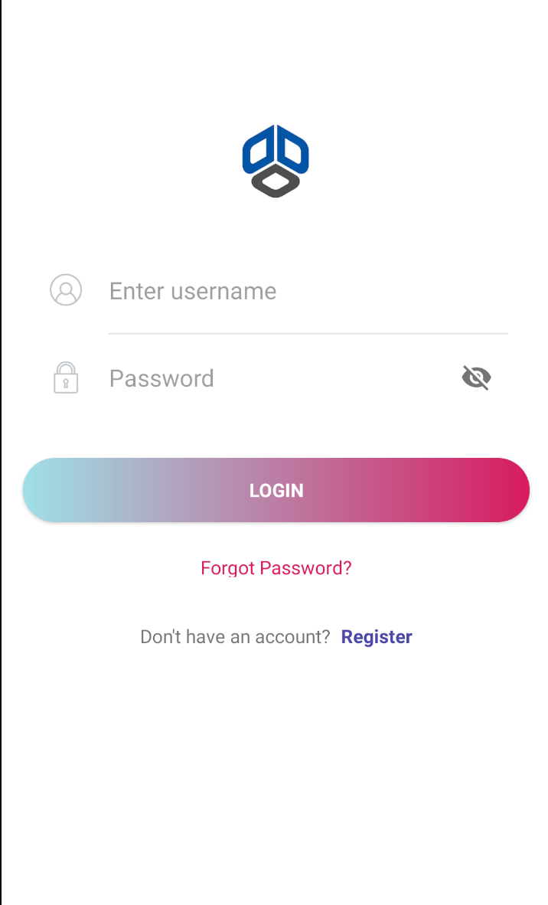
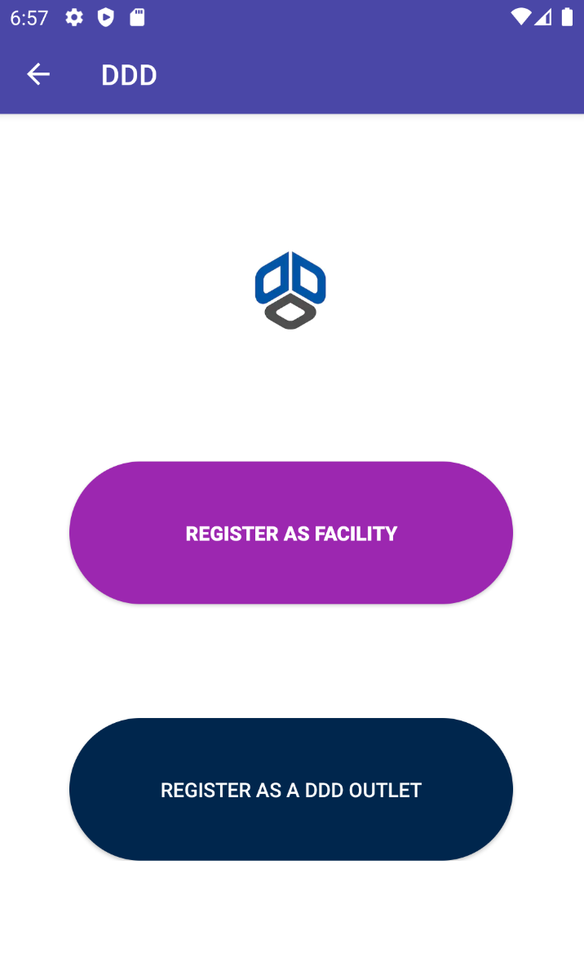
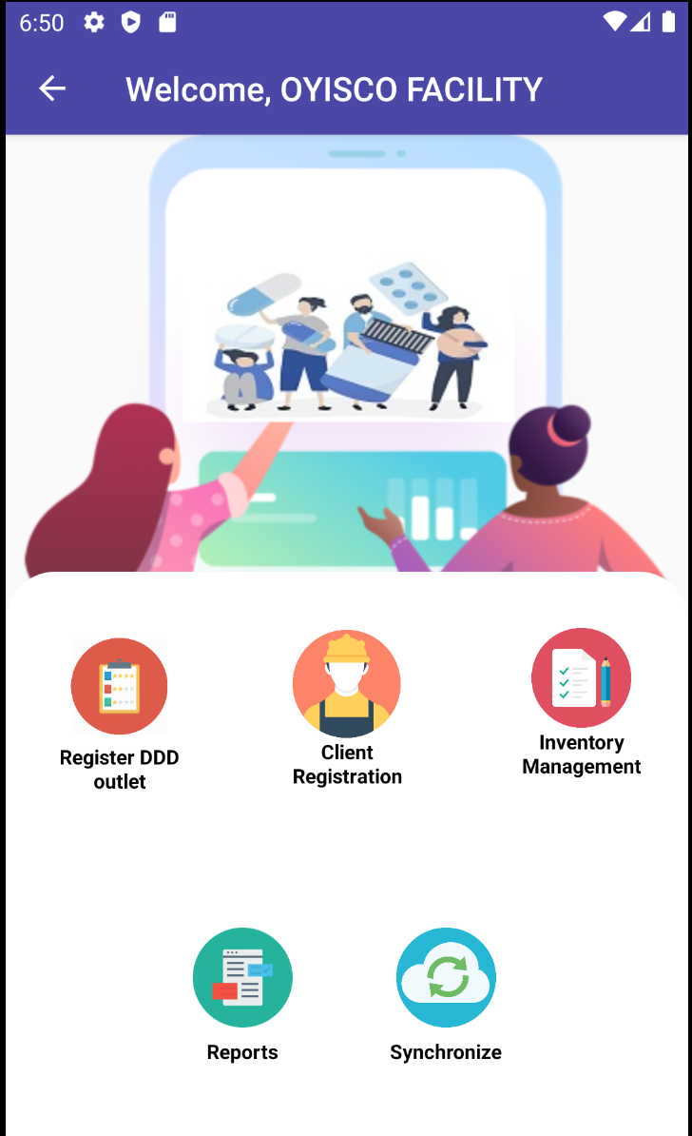
The DDD App
Generic online platform to allow real time data exchange between the public health facility “hub” (with or without EMR) and DDD outlet and in the long-term through patient portal will allow tripartite communication
Characteristics
Online and offline platform using a smartphone, tablet or laptop
Enabled interactive bi-directional communication
Secure sharing of patient information
Capacity for automated reminders and reports
Dashboards
Inventory management- From Hub or Central store

Slide 5
User roles
Health Facility (hub)
Facility login
Register DDD outlets
Enter devolved patient information (non EMR) or
Pull from data from EMR
Assign patients to DDD outlets
Use data from outlets to complete patient records where necessary
Generate reports
Allocate drugs
DDD Outlet
Receive activation code from facility
Install, login and retrieve patient information
Dispense medications and enter necessary patient information
Refer patients back to facility
Set refill dates and send reminders to patients
Synchronize data and generate reports
Request and receive drugs

Slide 6
Data and Security
Secure web hosting by recognized, high-capacity cloud hosting vendors
Secure sockets layer (SSL) encryption
App maintenance, and software elements that are updated to newest versions and patches
Limited identifying information
Securing client data through a secure login portal
Informed consent obtained from clients before they are devolved
Staff user guides are developed to outline user roles

Slide 7
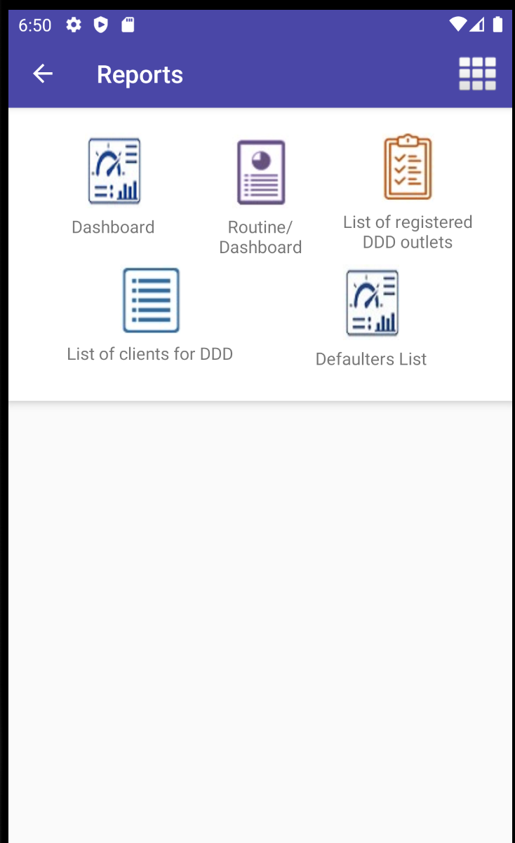
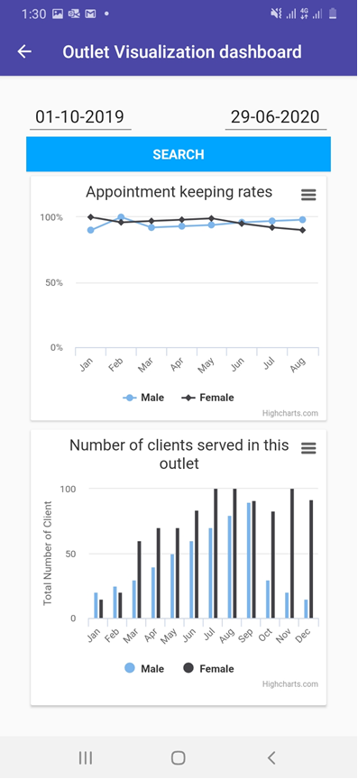
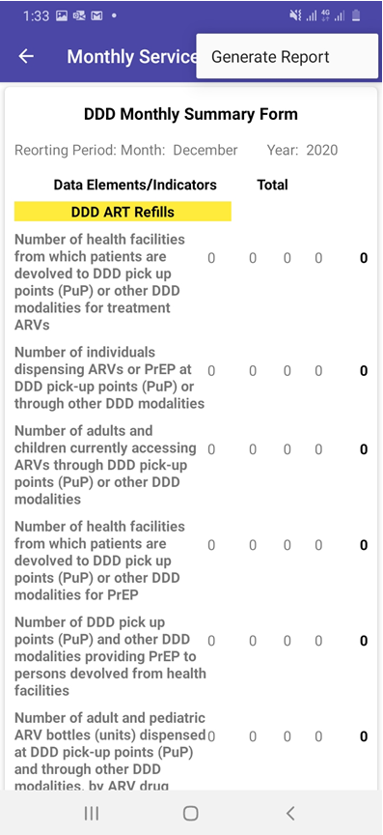
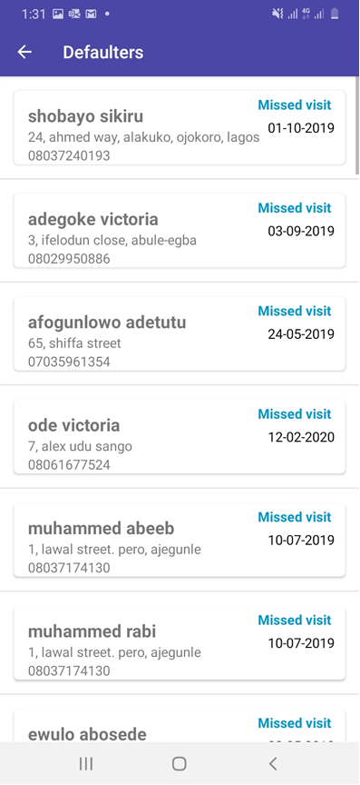
Reports
Data Visualization Dashboard
Hub facility app as well as DDD outlet
Appointment keeping rates
Number of clients served
Routine MER and non-MER reports
Can be exported via email
Defaulter list
For client tracking

Slide 8
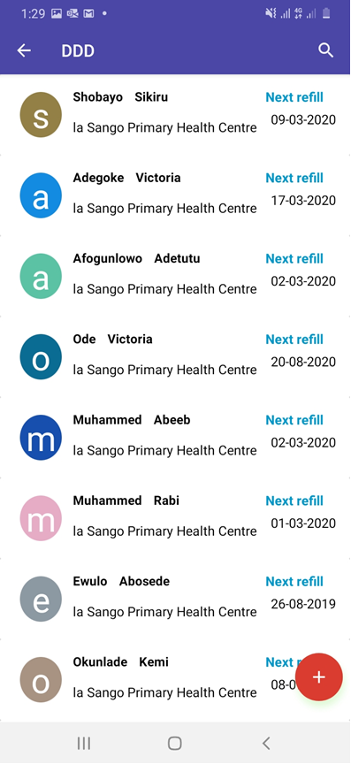
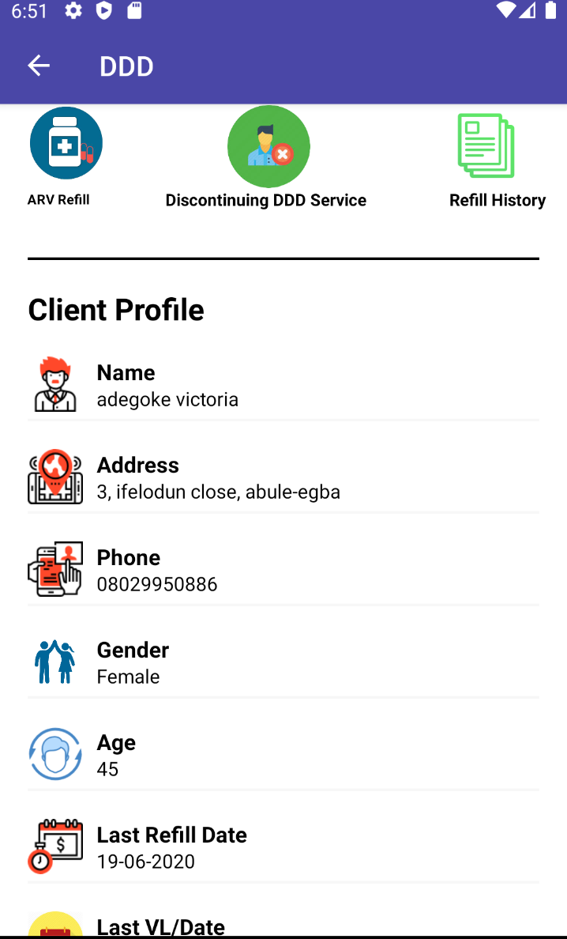
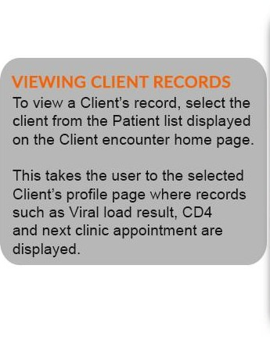
Refill outlet client list

Slide 9
Country adaptation
Routine reports matched to country required reports
In country logos: based on in country branding guidelines
Language options – user able to select country language
Cloud server/physical server for facilities without EMR – Can be managed by in country health informatics officers/ IT specialists
Seamless plugin and use by facilities with EMR through data mapping and use of API calls to the existing EMR
Generically configured to accept local IP address for facilities with local area network
App will available on google play and apple store for easy access

Slide 10
Agenda
Introductions
Basic features of the DDD App
Experience with using the App in Nigeria
Live demo
Discussion

Slide 11
Agenda
Introductions
Basic features of the DDD App
Experience with using the App in Nigeria
Live demo
Discussion

Slide 12
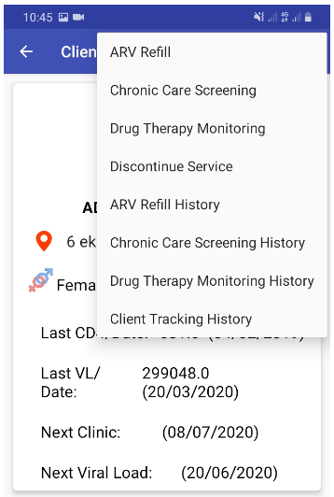
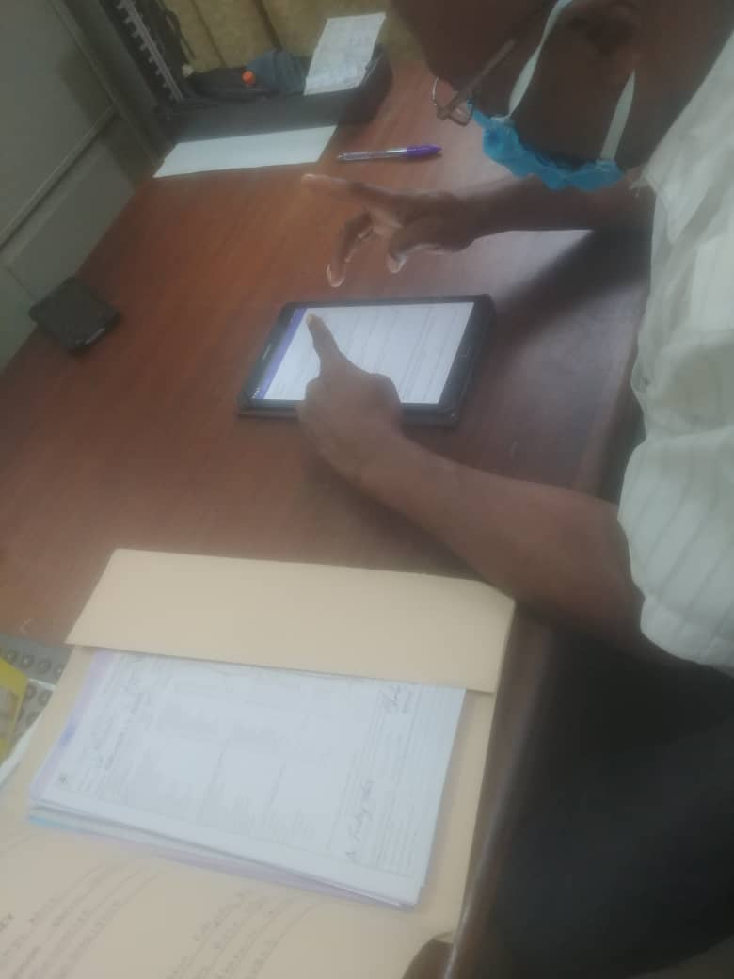
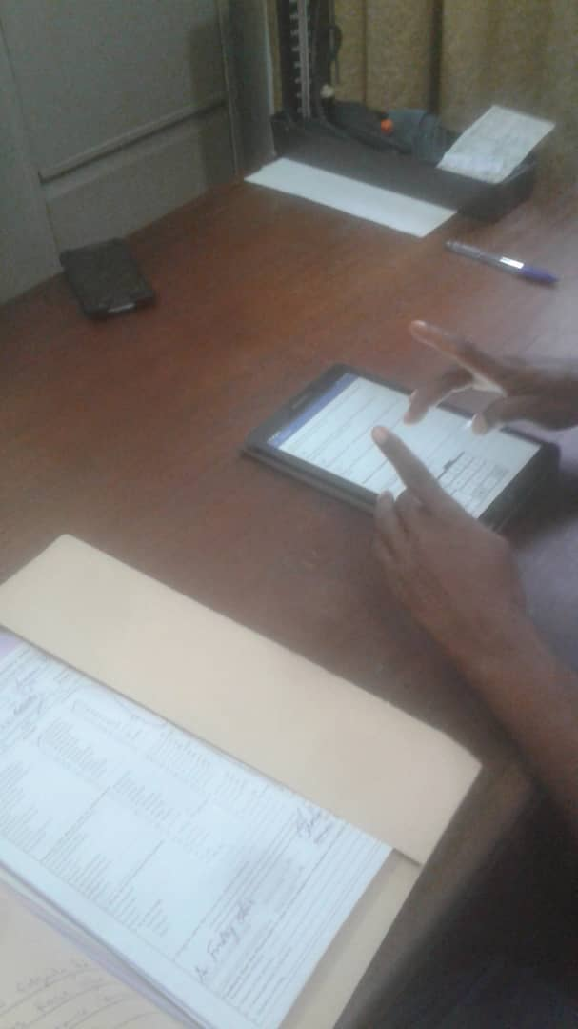
Using the App in Nigeria- domesticated as “CPARP Mobile”
It is currently in use in 44 community pharmacies (CP) with 2,773 devolved clients in Cross River State.
It has helped to significantly reduce documentation gaps for devolved clients.
Recurring challenges are;
Forgetfulness of hub facility and CP staff to click on the synchronize button, and
Poor internet connectivity, both of which affect synchronization of data between hub facility and CP.
These challenges are currently being resolved by automated synchronization once there is connection to the internet. Tablets are now internet-enabled
On-site use of CPARP mobile
Snapshots of the CPARP mobile in use at a community pharmacy in Calabar, Cross River State, Nigeria
Piloted in Lagos and Akwa Ibom, updated version to be implemented in Q4
LAMIS and LAMIS Light:

Slide 13
Agenda
Introductions
Basic features of the DDD App
Experience with using the App in Nigeria
Live demo
Discussion

Slide 14
Thank You

